Slide 1





Sairam.K
NM id: au711721243088
Final Project
1

Slide 2

PROJECT TITLE :
Building a Chatbot Using Keras and TF
2

Slide 3



AGENDA
PROBLEM STATEMENT
PROJECT OVERVIEW
WHO ARE THE END USERS?
YOUR SOLUTION AND ITS VALUE PROPOSITION
THE WOW IN YOUR SOLUTION
MODELLING
RESULTS
3

Slide 4

PROBLEM STATEMENT
Create a smart chatbot that understands users and replies using AI and deep learning. Goal: Build a chatbot that sorts user messages and gives fitting answers, improving interactions.
4

Slide 5

PROJECT OVERVIEW
This project aims to build a chatbot using Keras. The chatbot learns to understand user intents from text and gives appropriate responses.
Steps include preparing the data, creating a neural network with Keras layers like Embedding and Dense, training the model, and deploying the chatbot for real-time use.
The objective is to make a chatbot that interacts well, understands natural language, and responds effectively.
5

Slide 6
WHO ARE THE END USERS?
Customers: They use the chatbot in customer service scenarios to seek information, assistance, or support. The chatbot addresses common queries, provides product details, troubleshoots issues, and offers basic services.
Website Visitors: When integrated into a website, visitors become end users who utilize the chatbot for inquiries, site navigation, help requests, or interactive experiences.
Mobile App Users: End users accessing chatbot functionalities within mobile applications. They can ask questions, receive recommendations, or access personalized services through the app interface.
Employees: Within internal business applications, employees engage with chatbots for HR inquiries, IT support, accessing knowledge bases, scheduling, or workflow automation.
Students or Learners: In educational settings, students or learners interact with chatbots for learning support, answers to course-related questions, study tips, or engaging in interactive learning activities.
General Public: In public-facing applications like information portals, news platforms, or entertainment services, the general public uses chatbots for information, updates, recommendations, or entertainment purposes.
6

Slide 7
YOUR SOLUTION AND ITS VALUE PROPOSITION
Define Objectives: Clearly define the chatbot's purpose and target audience to ensure its functionalities and features meet the intended use cases effectively.
Select Technology Stack: Choose appropriate tools and frameworks, such as Keras, to streamline the development process and integrate natural language processing capabilities efficiently.
Data Preprocessing: Ensure data quality by normalizing and tokenizing inputs, preparing them for training to enhance model accuracy and effectiveness in understanding user intents.
Model Training: Utilize deep learning techniques to train the chatbot model, fine-tuning parameters to improve language understanding and generation of relevant responses.
Integration and Testing: Integrate the trained model into the deployment platform, conduct comprehensive testing to identify and address any issues, and refine the chatbot based on user feedback to optimize its performance and user experience.
7

Slide 8
YOUR SOLUTION AND ITS VALUE PROPOSITION
Cost Efficiency: By leveraging Keras and deep learning technologies, the chatbot automates tasks such as customer support, data entry, and information retrieval, reducing the need for human intervention and resulting in cost savings.
Improved Operational Efficiency: The chatbot streamlines processes by handling routine interactions, allowing human resources to focus on more complex tasks. This enhances overall operational efficiency within an organization.
Data Insights and Analytics: Through user interactions, the chatbot generates valuable insights like frequently asked questions, user preferences, and sentiment analysis. These insights inform decision-making, product improvements, and marketing strategies.
Enhanced Customer Service: With 24/7 support, consistent responses, and personalized recommendations, the chatbot improves customer satisfaction and loyalty. This strengthens the brand image and fosters positive customer relationships.
Competitive Advantage: Adopting AI-driven solutions like chatbots demonstrates technological innovation and responsiveness to customer needs. It sets a business apart in the market, attracting new customers and retaining existing ones by delivering superior user experiences.
7

Slide 9
THE WOW IN YOUR SOLUTION
Advanced NLP Techniques: Utilize cutting-edge natural language processing techniques, powered by Keras, for accurate language understanding and context-aware responses.
Seamless Integration: Integrate the chatbot seamlessly into existing platforms and systems, enhancing user experience and workflow efficiency.
Personalized Interactions: Implement personalized interactions through machine learning, creating a tailored experience for each user.
Continuous Learning: Enable the chatbot to learn and improve over time through feedback loops and adaptive algorithms.
Scalability and Performance: Design a scalable architecture that ensures high performance even under increased user load, ensuring a smooth and responsive chatbot experience.
8

Slide 10
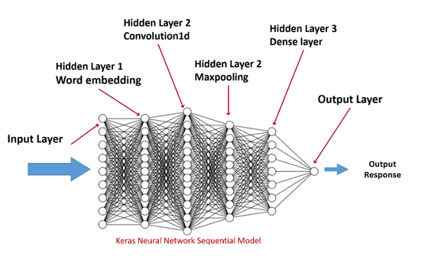
MODELLING
The model, built using Keras, operates by first tokenizing and encoding input text data to numerical sequences. These sequences are then fed into an embedding layer that transforms words into dense vectors, capturing semantic relationships. The subsequent layers, such as LSTM or Dense layers, process these embeddings to extract patterns and learn the underlying structure of the text data. During training, the model adjusts its parameters through backpropagation to minimize the loss function, optimizing its ability to classify intents or generate responses accurately. Regularization techniques like dropout are employed to prevent overfitting and enhance generalization. After training, the model can classify new input text by predicting the most probable intent or generating contextually appropriate responses based on learned patterns, providing a seamless and intelligent conversational experience in the chatbot system.
9

Slide 11
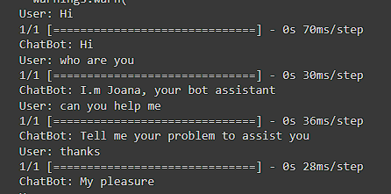
RESULTS
10

